Slide 1
Android Networking – Part 2
Minstrel Chiu
minstrelsy@gmail.com

Slide 2
Outline
REST
JSON
Retrofit
RxJava

Slide 3
REST (1)
REST (REpresentational State Transfer) is a way of providing interoperability between computer systems on the Internet for network-based software
Year 2000, in Roy Fielding’s doctoral dissertation
Comparison with SOAP, XML-RPC

Slide 4
REST (2)
Client-Server
Stateless
Cache
Uniform Interface
Layered System
Code-On-Demand

Slide 5

REST (3)
Client-Server

Slide 6
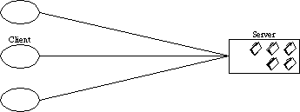
REST (4)
Stateless
Communication must be stateless
Session state is on client side

Slide 7
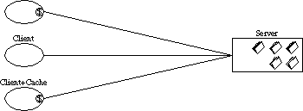
REST (5)
Cache
Client side cache
Server side cache

Slide 8
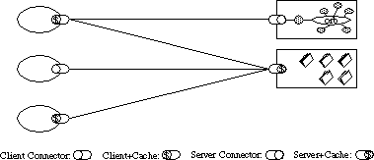
REST (6)
Uniform Interface

Slide 9
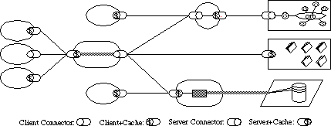
REST (7)
Layered System

Slide 10
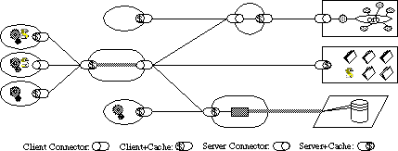
REST (8)
Code-On-Demand

Slide 11
REST (9)
An architecture for Web service which adhere to REST is called RESTful
Everything in REST in considered as a resource
A resource is identified by an URI (Uniform Resource Identifier)
Use uniform interfaces for handling Create, Read, Update, Delete (CRUD) operations by HTTP POST, GET, PUT, DELETE
Be stateless
Transfer representation in HTML, XML or JSON

Slide 12
REST (10)
Resource | POST Create | GET Read | PUT Update | Delete Delete
/users | Create a new user | List all users | Update all users entirely (in batch) | Delete all users
/users/1234 | Not used, an error is returned | Retrieve an user | Update an user | Delete an user

Slide 13
REST (11)
Bad | Good
/api/getAllUsers | GET /api/users
/api/getUserById?id=1234 | GET /api/users/1234
/api/createUser | POST /api/users

Slide 14
JSON (1)
JSON (JavaScript Object Notation) is an open standard data format for human readable data interchange
Text based
Human readable
Light weighted
Language independent
Comparison with XML

Slide 15
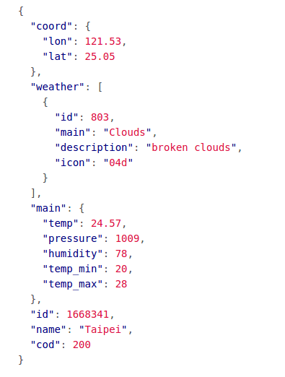
JSON (2)
Data Types
Number – double
String
Boolean – true or false
Array – []
Object – {}
null

Slide 16
JSON (3)
Sample-JSON-1 – JSON parsing demo

Slide 17
Retrofit (1)
Retrofit is a type-safe HTTP and REST client for Android and Java by Square
Supports multiple convertors such as JSON and XML
Uses OkHttp for HTTP requests

Slide 18



Retrofit (2)
GET /users → getUsers()
GET /users/1234 → getUser(1234)
GET /users?sort=desc → getUsers(“sort”)

Slide 19

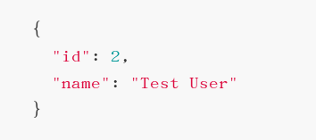
Retrofit (3)
POST /users → createUser()

Slide 20

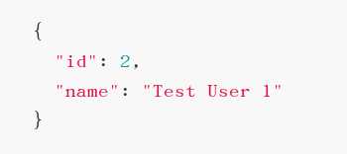
Retrofit (4)
PUT /users/1234 → updateUser(1234)

Slide 21

Retrofit (5)
DELETE /users/1234 → deleteUser(1234)

Slide 22
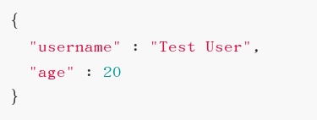
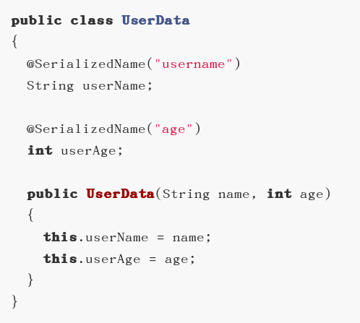
Retrofit (6)
JSON Data
Java Class

Slide 23
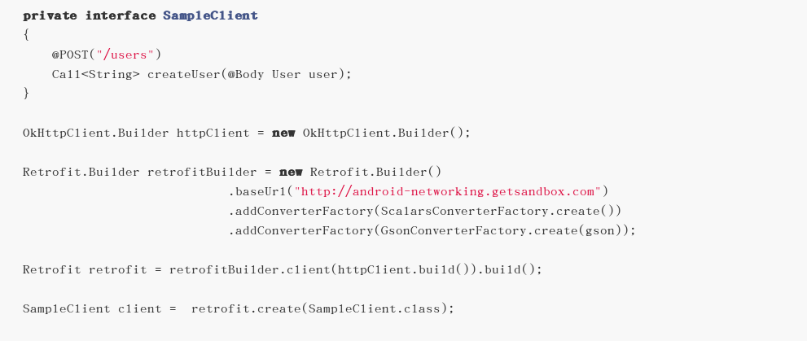
Retrofit (7)

Slide 24
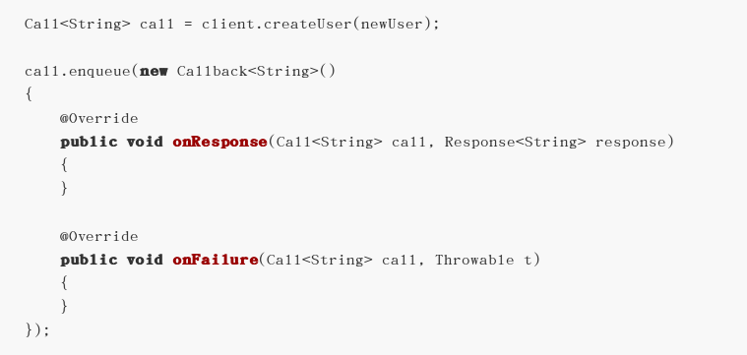
Retrofit (8)

Slide 25
Retrofit (9)
Sample-Retrofit-1 – Retrofit GET/POST demo

Slide 26
RxJava (1)
RxJava is a Java VM implementation of Reactive Extensions: a library for composing asynchronous and event-based programs by using observable sequences
RxAndroid is usually used with RxJava
Retrolambda is required for Lambda Expressions in Java7

Slide 27
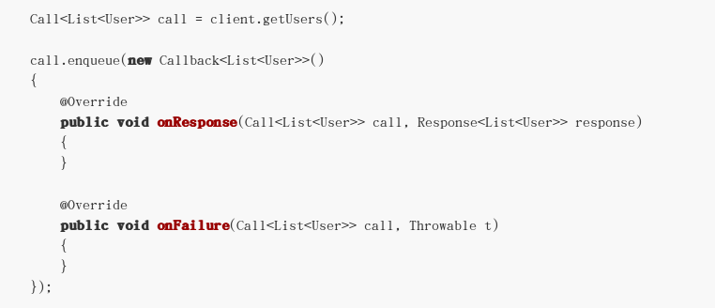
RxJava (2)
Pure Retrofit

Slide 28
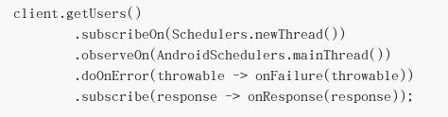
RxJava (3)
Retrofit + RxJava + RxAndroid + Retrolambda

Slide 29
RxJava (4)
Sample-RxJava-1 – RxJava+RxAndroid+Retrolambda demo

Slide 30
Questions?

Slide 31
Coursework
GET https://api.github.com/users/minstrelsy/repos by using Retrofit
Parse the name of repos and display them on UI
Using RxJava + RxAndroid + Retrolambda is optional

Slide 32
References
JSONObject
JSONArray
Representational State Transfer (REST)
Architectural Styles and the Design of Network-based Software Architectures
URI
Retrofit
Retrofit Tutorials
RxJava
RxAndroid
Retrolambda
How To Use RxJava

